Slide 1
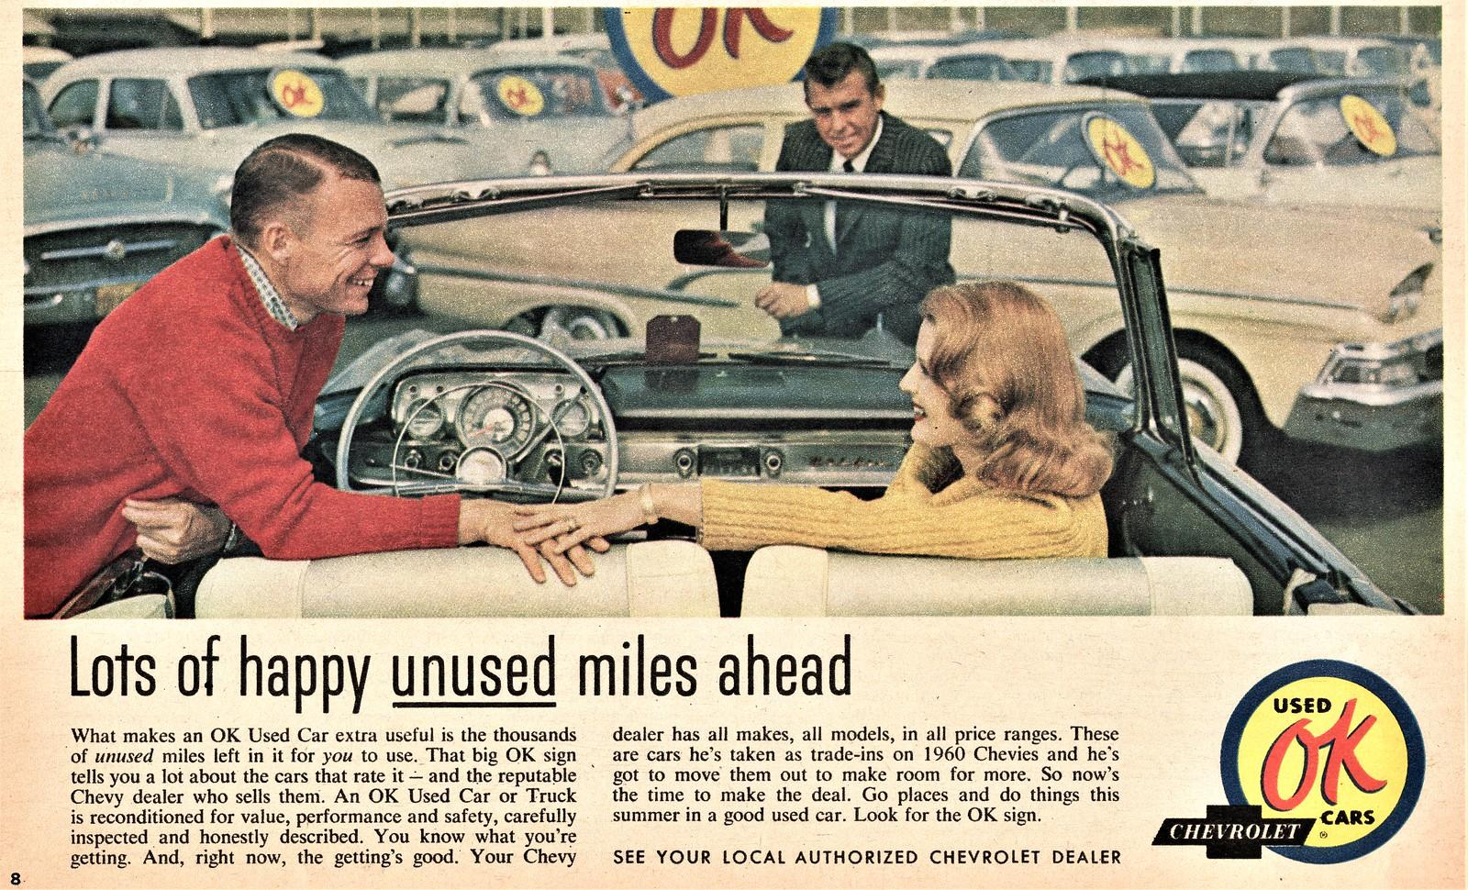
Used Car Price Prediction in a Marketing Perspective
By Rama Krishna Bonthagorla

Slide 2

Objective: The main objective of this project is to develop a model that can predict the price of used cars based on various attributes such as brand, model year, mileage, fuel type, and other key factors. This can help dealerships and customers understand pricing trends, allowing for better decision-making when buying and selling used cars.

Slide 3
Business Context:
Used car dealerships often face challenges in setting the right price for their vehicles. Pricing too high could reduce sales, while pricing too low might lead to lower profit margins.
Understanding the key factors influencing car prices can help dealerships price their inventory more competitively, maximizing their profit while ensuring their vehicles are attractive to buyers.
A data-driven approach to predict car prices will offer insights into how features such as mileage, car condition, brand, and model year affect a vehicle's resale value.

Slide 4
Key Features:
Brand: Different car brands can command different prices. Luxury brands like Lexus or Audi might have higher prices than economy brands like Hyundai or Ford.
Model Year: The age of the vehicle plays a crucial role in its depreciation rate. Newer models generally fetch higher prices.
Mileage: A vehicle's mileage is often used as a proxy for wear and tear. Higher mileage typically reduces the resale value.
Fuel Type: Cars with alternative fuel types (such as electric or hybrid) may have a different pricing structure compared to gasoline-powered cars, reflecting changing consumer preferences and fuel costs.
Accident History: Cars with a clean title (no accident history) generally have higher resale value compared to those with accident histories.

Slide 5
Impact:
Dealerships: Predicting prices accurately can help dealerships set competitive prices, improve their marketing strategies, and adjust their inventory pricing based on market dImpact:
Dealerships: Predicting prices accurately can help dealerships set competitive prices, improve their marketing strategies, and adjust their inventory pricing based on market demand.
Buyers: Consumers can make more informed decisions by comparing the predicted prices with actual market trends.
Marketing: Dealers can highlight features of their cars that are highly valued in the market, offering better-targeted advertisements for customers interested in specific features or price ranges.emand.
Buyers: Consumers can make more informed decisions by comparing the predicted prices with actual market trends.
Marketing: Dealers can highlight features of their cars that are highly valued in the market, offering better-targeted advertisements for customers interested in specific features or price ranges.

Slide 6
Understanding the market

Slide 7

Optimized Pricing Strategies:
By accurately predicting used car prices, dealerships can set competitive prices that attract potential buyers while maximizing profits. Predictive models help identify market trends, making it possible to adjust pricing dynamically based on factors such as brand, model year, mileage, and fuel type.
This allows dealerships to price cars based on demand elasticity, offering promotions on underpriced cars and adjusting for overpricing on others. As a result, dealerships can stay competitive while maintaining profitability.

Slide 8
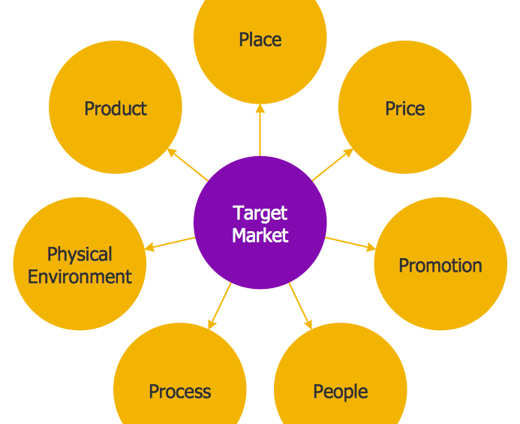
Improved Customer Segmentation:
Predictive pricing models provide insights into the factors that most influence price sensitivity across different customer segments. By analyzing these patterns, dealerships can tailor marketing strategies to target specific segments more effectively.
For example, customers interested in eco-friendly vehicles like hybrids or electric cars can be targeted with specific promotions, while luxury car buyers can be offered high-end deals based on the car's predicted value.

Slide 9

Inventory Management Optimization
Accurate price prediction models can help dealerships identify which cars are likely to sell at higher prices and which might require additional marketing efforts to move.
By analyzing predicted prices and historical sales data, dealerships can adjust their inventory mix and focus on high-demand vehicles, reducing holding costs and increasing turnover.

Slide 10

Personalized Marketing Campaigns
With the insights provided by price prediction models, dealerships can create personalized marketing campaigns that focus on promoting cars that meet the predicted needs of different customer groups.
For instance, a buyer looking for a high-performance luxury vehicle may be shown ads for a 2020 Audi A6 with a predicted price in a competitive range. Conversely, an eco-conscious buyer may see marketing material for hybrids and electric vehicles, priced competitively

Slide 11

Forecasting Sales and Demand:
Predictive models can forecast not only prices but also sales trends. By analyzing the factors that influence prices, dealerships can anticipate future demand for specific car models or brands.
If a dealership knows that used Toyotas are predicted to see an increase in demand in the coming months, they can market those models aggressively, ensuring they have the right inventory to meet customer demand.

Slide 12



Enhanced Customer Trust and Satisfaction:
By offering well-priced cars based on predictive insights, dealerships can build customer trust by being transparent about the pricing and offering fair deals. Transparent pricing models are especially attractive to customers who are wary of overpaying in an often-price-sensitive market.
Furthermore, buyers will appreciate the consistency in pricing, which fosters long-term relationships and increases the likelihood of return business.

Slide 13

Competitive Edge through Technology:
Dealerships using predictive pricing models can position themselves as technology-driven, offering a modern and efficient buying experience. This not only helps build a strong brand image but also appeals to tech-savvy customers who prefer making data-driven decisions.
Additionally, it can provide a competitive edge in a saturated market where price and value are often the determining factors in purchase decisions.

Slide 14

Increased Lead Conversion:
By setting optimal prices and targeting customers with the right price points, dealerships can improve lead conversion rates. Predictive pricing enables dealerships to convert more leads into sales, as customers feel they are getting the best deal for the value.
Additionally, predictive models can help identify potential leads that are more likely to convert based on their browsing and buying behaviors, allowing dealerships to focus on high-conversion leads.

Slide 15
Insights from the Dataset

Slide 16
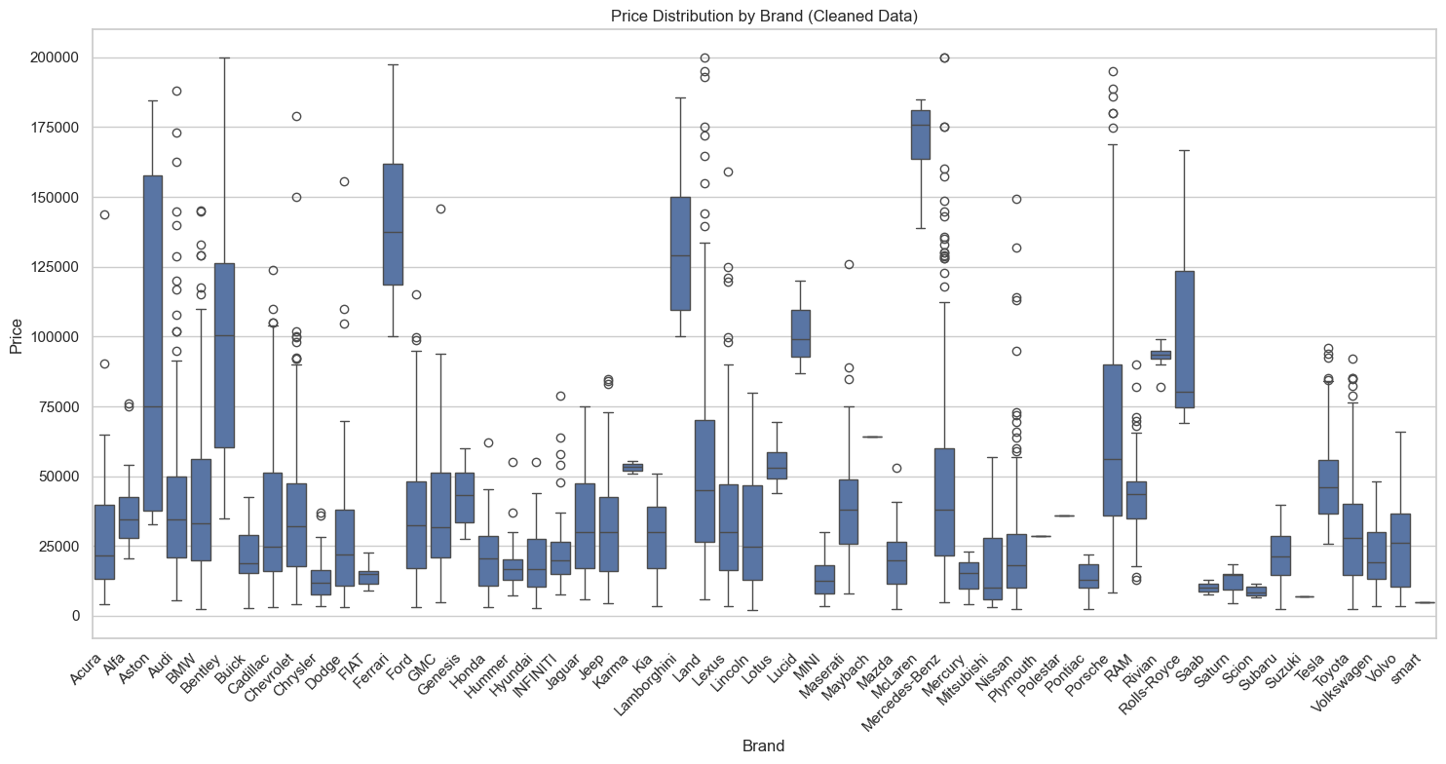

Slide 17
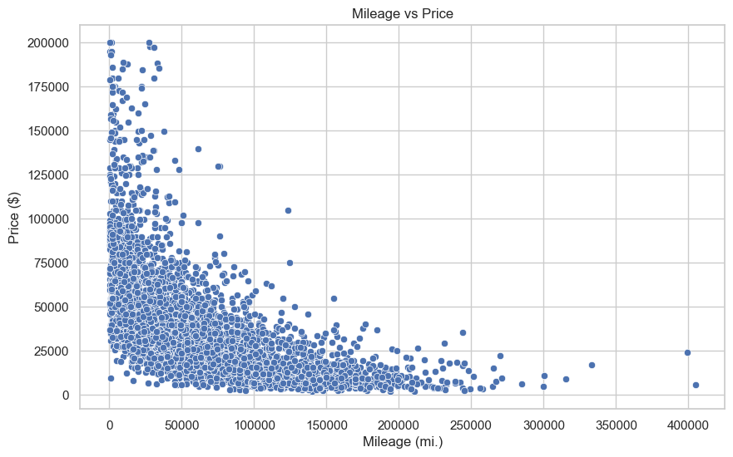

Slide 18
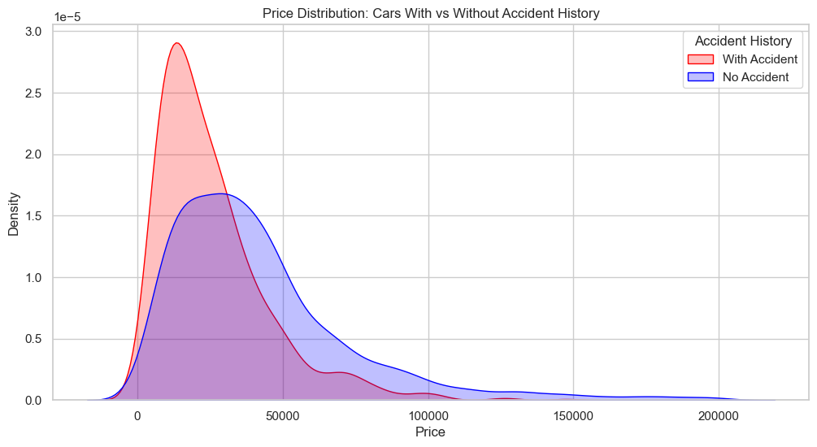

Slide 19
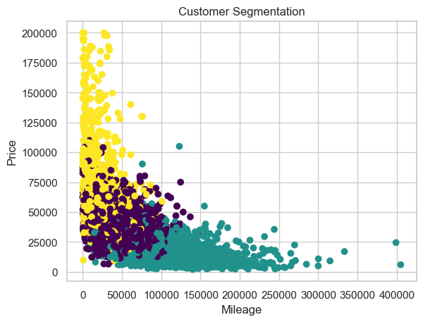
Segment 1 (Luxury Buyers): High price and newer model years.
Segment 2 (Eco-Friendly): Preference for hybrid or electric fuel types.
Segment 3 (Budget-Conscious): Lower price, higher mileage.

Slide 20
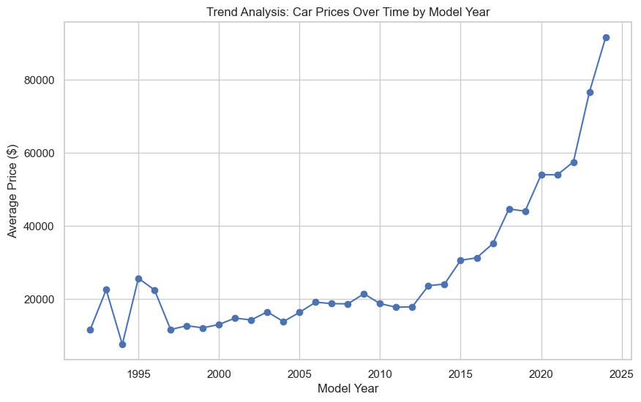

Slide 21
Model Building
The Mean Absolute Error (MAE) of 12,549.40 suggests that, on average, the model's predictions for car prices are off by approximately $12,549.40.
Interpreting the MAE:
High MAE: This indicates that the model is not highly accurate in predicting car prices. The error margin of about $12,549 may be too large for practical use in a real-world application like price prediction for used cars, depending on the price range you're targeting.
Possible Causes:
Feature Engineering: The features selected (e.g., mileage, model year, fuel type, brand) may not fully capture the variability in car prices. You might need to add more relevant features such as condition, color, vehicle history, or market trends.
Data Quality: If the dataset has noise, missing values, or outliers, it could negatively affect the model's performance.
Model Complexity: Random Forest is a powerful model, but it might require hyperparameter tuning to achieve better results.
Categorical Features: Label encoding for categorical variables like fuel_type and brand might cause issues due to arbitrary numeric representations. You could try one-hot encoding these columns for better performance. The MSE got reduced to 10,608 after using one hot encoding.

Slide 22
Summary:
In a marketing context, using a used car price prediction model can empower dealerships to improve decision-making, drive customer engagement, and optimize pricing strategies. By predicting car prices accurately, dealerships can enhance customer satisfaction, manage inventory efficiently, and remain competitive in a crowded market. Additionally, it helps tailor marketing campaigns, drive sales, and maintain a transparent, trustworthy relationship with customers.

Slide 23
Thank you.

